Slide 1

Express.js serverio
kūrimas (7)
Dėstytojas
2 LYGIS
3 DALIS
Node.js

Slide 2
Šiandien išmoksite
JavaScript programavimo kalba
01
Express.js + Server side rendering (SSR)

Slide 3
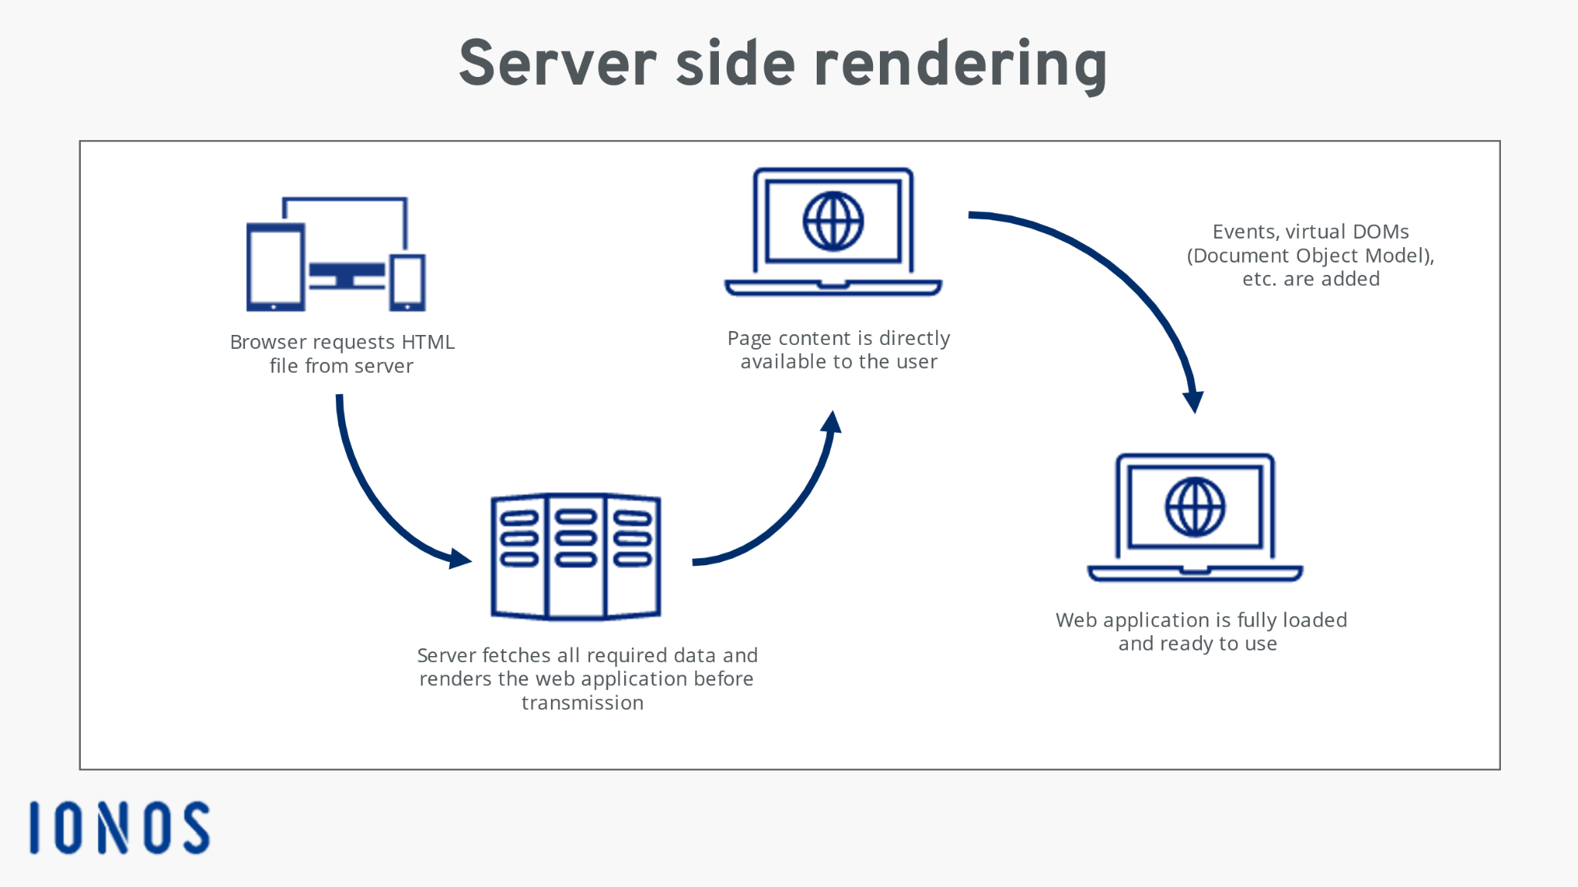
Express.js + Server side rendering (SSR)
Node.js
Praktika su Express.js + Server side rendering (SSR) naudojant “EJS template engine”.

Slide 4
Naudinga informacija
Node.js
Informacija
https://expressjs.com/en/guide/using-template-engines.html
http://expressjs.com/en/starter/examples.html
https://ejs.co/
https://www.freecodecamp.org/news/what-exactly-is-client-side-rendering-and-hows-it-different-from-server-side-rendering-bd5c786b340d/

